Slide 1
Category review: Chips
June 2020
Retail Analytics
Brand note: If client logo is not required, use alternate title page layout right click slide thumbnail > Layout > Title

Slide 2
Notes:
To view Privacy video explaining how important data privacy is to Quantium, please click here: https://www.youtube.com/watch?v=Zq1QDAkoRzU
or here Q:\Company Reference\Brand & Design\Brand videos\Q Privacy.mp4
At Quantium, we believe that data is the behavioural footprint of humanity and that it has to be treated with the utmost care and responsibility.
Histories, attitudes, indeed lives are stored within it in ways that aren’t always apparent – and that’s what makes its potential so powerful.
To work with it responsibly, sensitively, we set ourselves the highest data privacy protection and governance standards.
We have spent 17 years perfecting privacy-by-design and secure-by-design principles. Central to this is not holding any personally identifiable information about people –
we neither receive it, and put the necessary protections in place to be unable to decipher it.
Every aspect of handling data is safeguarded: from its de-identification, to its encryption – data security is paramount and of the highest grade.
We pride ourselves on gaining the trust of iconic organisations around the world through years of securely working with their data,
and in turn the trust that builds with their stakeholders.

Slide 3
Executive summary
01
Task 1
Category :
Chips Sales Analysis Summary
Kettle, Doritos, and Smith’s 175g packs are the top-selling chip products by volume and sales. Young singles/couples dominate the Mainstream segment and represent a key growth opportunity, as they may evolve into higher-consuming family segments over time.
02
Task 2
Trial store performance :
Store Sales Analysis Summary:
Trial stores (STORE_NBR 77, 86, 88) showed a clear increase in purchasing trends compared to their matched control stores (STORE_NBR 41, 109, 201), selected using Pearson correlation. The positive outcome suggests the intervention was effective and could boost chip sales further if expanded to other stores.

Slide 4
01
Category

Slide 5
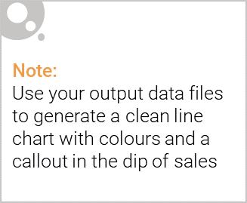
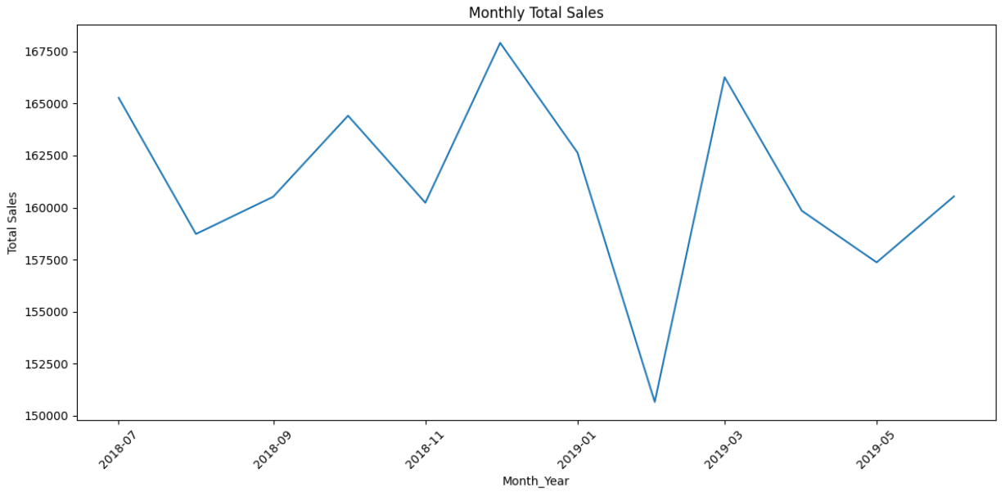
Overview: Customer purchasing trends vary across different periods. A noticeable decline in purchasing power is observed at the beginning of Year.

Slide 6
As we visualise the Premium Category, Mainstream dominates the most in over all sales (38.51%).

Slide 7

Young Singles/Couples contribute the highest sales within the Mainstream segment. By strategically targeting this group, we can potentially boost overall purchasing trends, as they are likely to transition into Older Singles/Couples or Young Families in the future—segments that may continue or even increase their chip consumption over time.

Slide 8
02
Trial store performance

Slide 9
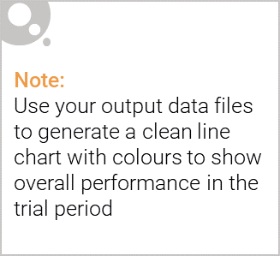
Explanation of Control Stores vs Trial Stores
To evaluate the effectiveness of the intervention (such as a layout change, promotion, or marketing campaign), a control group of stores was selected to serve as a baseline for comparison. These control stores were carefully matched to the trial stores using Pearson correlation, ensuring that their historical purchasing patterns were similar prior to the intervention.
Trial Stores: STORE_NBR 77, 86, and 88 were selected to implement the new strategy or layout being tested.
Control Stores: STORE_NBR 41, 109, and 201 were chosen as comparable stores that did not receive the intervention.
By comparing sales trends in the trial stores against those in the control stores over the same time period, we were able to isolate the effect of the intervention from other external influences (e.g., seasonal trends, overall market growth).
The results showed that trial stores consistently outperformed their control counterparts, suggesting that the observed increase in sales was indeed a result of the implemented changes — and not due to random variation or broader market effects.

Slide 10
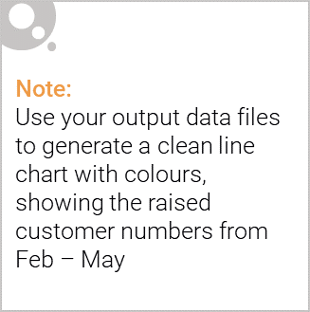
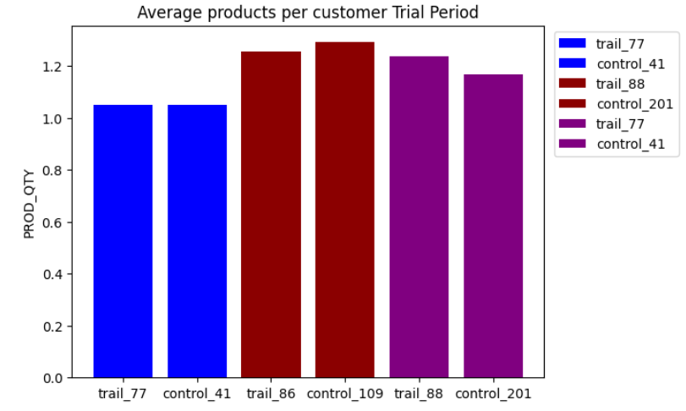
New store layout may be positively impacting performance. Indicators such as total sales, number of products sold, repeat customer rate, and average transactions per customer all show that the trial stores are outperforming the control stores.

